Slide 1
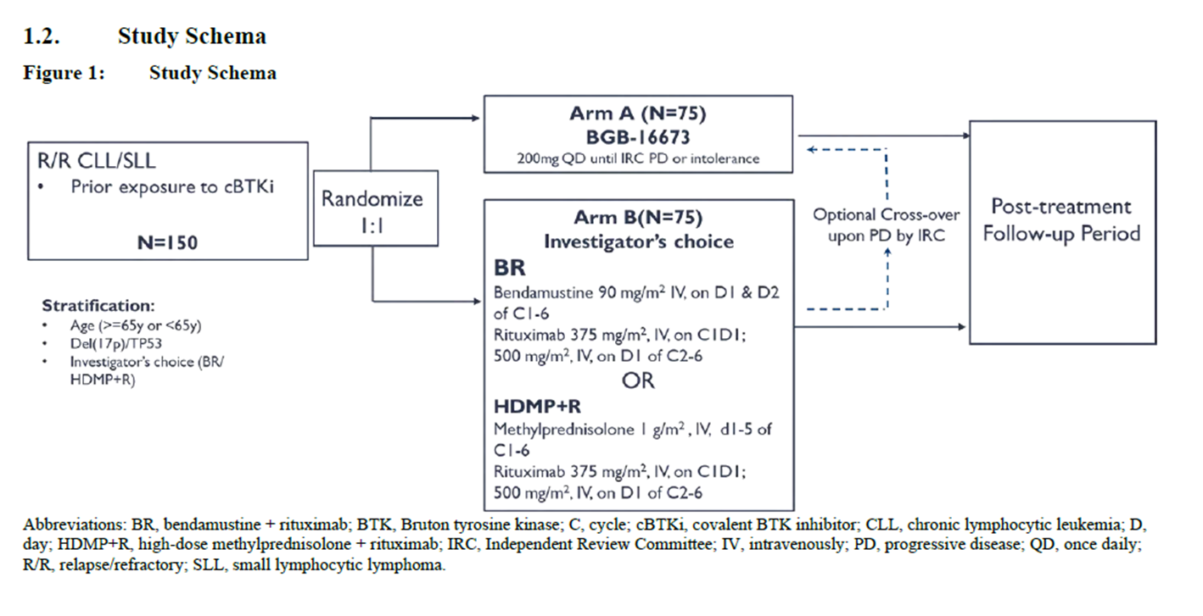
BGB-16673-303 Study Schema

